Slide 1
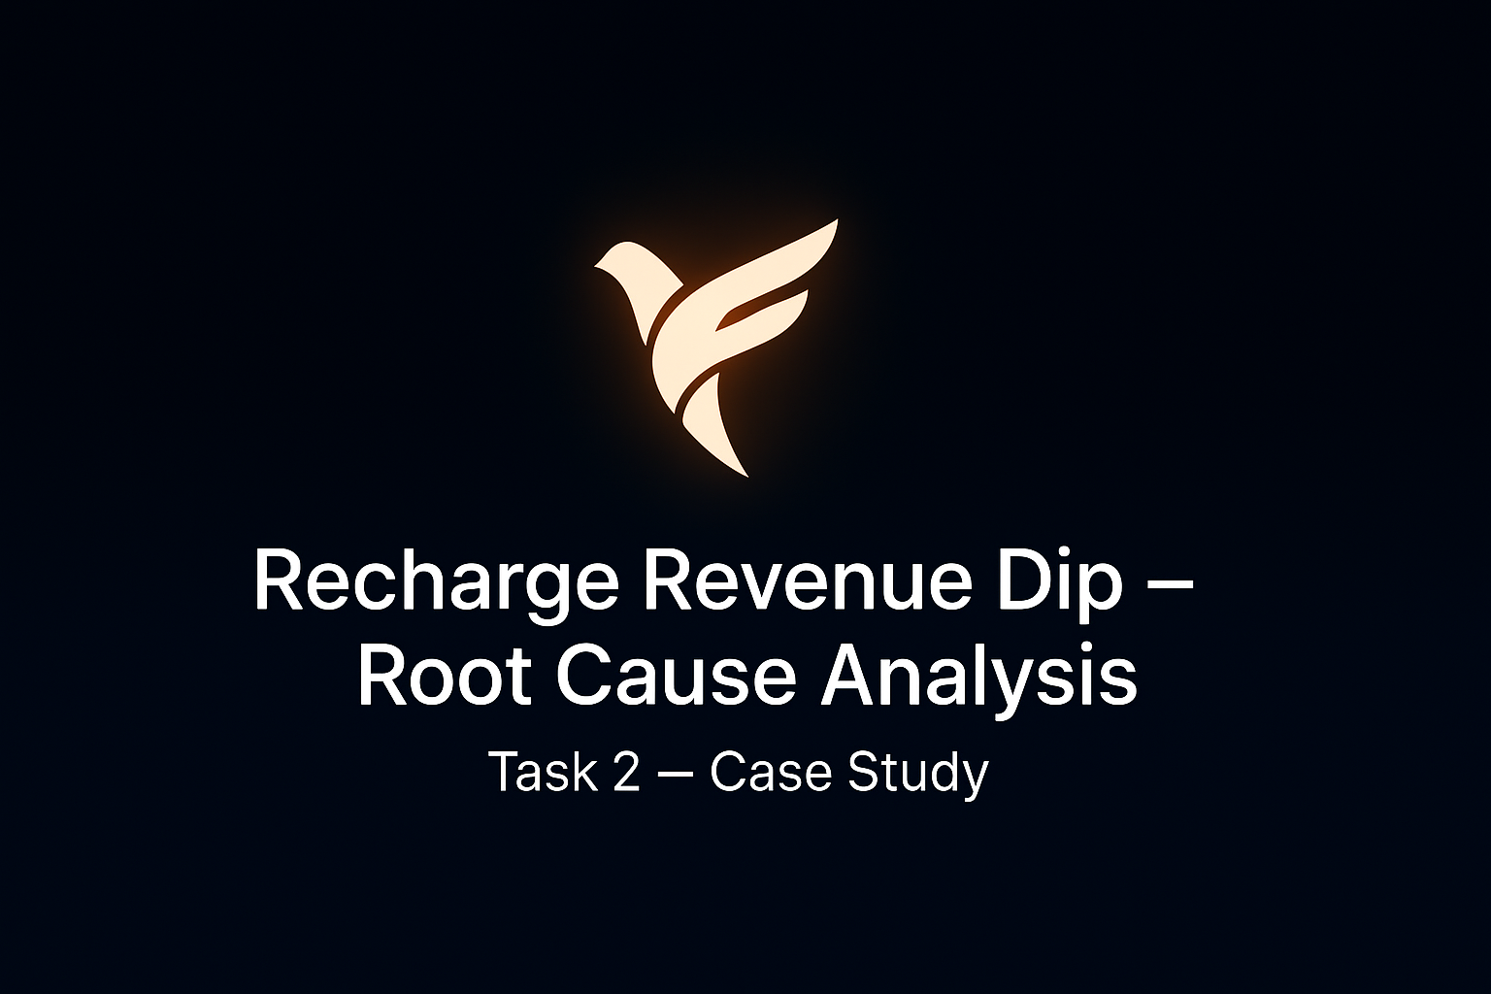

Slide 2
Context & Objective
Context: Recharge is a key revenue driver for FamApp (commissions + cross-sell).
Problem: In the last 10 days, GMV fell by 25% and successful recharges dropped by 40%..
Goal: Find where the funnel is leaking, Identify root causes behind funnel drop- offs and propose fixes.

Slide 3
FUNNEL BREAKDOWN
Where are we losing users?
Browse → Plan Selected: 70% → 58% (12% drop)
More users are browsing recharge plans but not selecting one. This suggests potential issues such as unclear plan options, overwhelming choices, or reduced trust in whether the recharge will go through.
Plan Selected → Payment Initiated: 90% → 80% (10 % drop)
Drop could mean hesitation to commit to payment (lack of trust/new users?)
Payment Initiated → Success: 80% → 64% (16 % drop)
This is the steepest drop in the funnel. The main drivers are UPI failures (success rate down 15%) and operator timeouts, especially with Operator X. Since UPI is the most popular method, even small dips create a large impact.
Payment Success → Confirmed: 95% → 83% (12% drop)
Even after payment success, many recharges are not confirmed immediately. Operator Y delays (1–2 hrs) make users feel like the recharge has failed, doubling complaints like “money deducted but recharge not received.”

Slide 4
ROOT CAUSES
Primary Issues:
Operator X (55% share): Timeout errors have tripled in the last 10 days. Since more than half of all recharges go through Operator X, this directly explains a big portion of failures.
UPI Reliability Dip (−15%): UPI is the dominant payment method for our users. A 15% dip in UPI success hits not just recharges but the entire payment funnel, creating a ripple effect across transactions.
Secondary Issues:
Operator Y Delays (1–2 hrs): Even though Operator Y handles a smaller share (20%), delays of 1–2 hours in confirmations are extremely frustrating. Users perceive a completed payment as a failed recharge when there is no instant confirmation.
User Frustration & Trust Issues: Support tickets mentioning “money deducted but recharge not received” have doubled, and social complaints have spiked. This signals growing distrust and negative sentiment, which can harm long-term retention.

Slide 5
PRIORITIZATION
Operator X Reliability (Top Priority)
Handles 55% of all recharges → any issue here impacts the majority of users.
Timeout errors have spiked 3×, making it the single largest contributor to failed transactions.
Fixing Operator X stability will create the biggest immediate uplift in recharge success.
UPI Success Rates
UPI is the most widely used payment method.
A 15% drop in success affects not just recharges but the overall user trust in payments across the app
Improving UPI reliability ensures a healthier funnel across multiple product flows, not just recharges.

Slide 6
PRIORITIZATION(CONTINUED)
Operator Y Delays
Though smaller in share (20% of users), delays of 1–2 hours create perceived failures.
These cases directly translate into negative sentiment, higher support tickets, and social media complaints.
Addressing delays improves user confidence and reduces churn risk.
Takeaway: Tackling Operator X + UPI issues first solves the biggest leaks, while Operator Y delays must be handled to rebuild trust.

Slide 7
SHORT TERM ACTIONS
. In-App Communication on Failures/Delays
Show real-time alerts when certain operators (e.g., Operator X) are unstable.
Prevents users from repeatedly retrying and getting frustrated.
Builds transparency & trust by setting the right expectations.
Fallback Payment Suggestions
If UPI fails, proactively suggest alternate methods (wallet, card).
Reduces friction and helps users complete recharges successfully on first attempt.
Faster & Automatic Refunds
Commit to near-instant refunds (e.g., within 30 mins) when a payment fails.
Avoids “money stuck” frustration that leads to support tickets and negative social mentions.
Support Transparency & Auto-Updates
Auto-send messages like: “Recharge confirmed, but operator may take 1–2 hrs to update.”
Reassures users that their money is safe → reduces unnecessary panic and ticket volume.
Takeaway: These quick interventions won’t fully fix infra issues, but they can significantly reduce user pain and stop trust erosion while longer-term fixes are implemented.

Slide 8
Long-Term Strategy
Operator Diversification & Partnerships:
Reduce heavy dependence on Operator X by onboarding/strengthening ties with other operators.
Negotiate SLAs (service-level agreements) to ensure guaranteed uptime and faster confirmations.
Lowers risk of a single operator outage sinking the funnel.
Stronger Payment Infrastructure:
Add retry logic for failed UPI attempts (auto-retry with another gateway).
Integrate multiple payment gateways to improve reliability and spread risk.
Monitor UPI health in real-time to quickly reroute traffic during failures
Real-Time Monitoring & Alerting:
Build dashboards that track funnel conversion drops hour by hour, not after 10 days.
Alerts for sudden operator or payment failures allow faster mitigation.

Slide 9
LONG TERM STRATEGY
Building User Trust Features
Show live success rates on the recharge screen (e.g., “99% success today”).
Offer guarantees like “Recharge or Refund in 30 mins”.
Improves confidence and positions FamApp as the most reliable recharge option.
Takeaway: In my view as a customer, long-term resilience comes from a mix of infra reliability + proactive transparency. This ensures recharge stays a stable and trusted revenue driver.

Slide 10
Metrics to Track (2–4 Weeks)
Funnel Conversion Rates (Daily Monitoring)
Track each stage: Browse → Plan Selected → Payment Initiated → Payment Success → Confirmed.
Quickly identifies where drop-offs are happening and whether fixes are working.
Operator-Specific Performance
Success rate, timeout rate, and confirmation delays split by Operator (X, Y, others).
Helps validate whether operator fixes are stabilizing.
Payment Method Reliability
UPI vs Non-UPI (wallet, card) success rates.
Ensures alternate payment suggestions are effective and UPI recovery is on track.
Refund & Resolution Speed
Average time taken to process refunds for failed transactions.
A strong signal for user trust and reduced complaint load.
User Pain Signals
Volume of recharge-related support tickets.
Social media mentions of “failed recharge” or “money deducted.”
Takeaway: Tracking these KPIs daily/weekly ensures that short-term fixes are effective and long-term strategies are delivering sustainable results.

Slide 11
Final Summary & Recommendations
Key Insights:
Recharge funnel dropped due to Operator X timeouts and UPI failures.
Operator Y delays caused perception of failure, fueling user frustration.
Support tickets doubled, showing trust erosion beyond just metrics.
Recommendations:
Immediate Fixes (Quick Wins)
Communicate outages in-app.
Promote alternate payment methods when UPI fails.
Offer instant refunds + auto status updates.
2. Medium-Term Priorities
Fix Operator X reliability.
Reduce Operator Y delays with stricter SLAs.
Long-Term Strategy
Build operator diversification.
Invest in real-time anomaly monitoring.
Introduce user trust signals (live success rates, refund guarantees).

Slide 12
BY ,APPLICANT PRODUCT ANALYST INTERN -SAI GAUTHAM GODALA

